Slide 1
Bayesian Data Analysis
Unit 5
Fall 2022

Slide 2
References
Norman Fenton and Martin Neil, “Risk Assessment and Decision Analysis with Bayesian Networks,” CRC Press, 2nd ed. 2019, Chapter 6 (RDBN, 2019)
Pasman, Hans J., Risk Analysis and Control for Industrial Processes-Gas, Oil and Chemicals: A System Perspective for Assessing and Avoiding Low-Probability, High-Consequence Events, Elsevier, 2015
Ang, A.H-S. and Tang, W.H., Probability Concepts in Engineering, 2nd ed, Wiley, 2010 (Ang, PCE)
M. Modarres, Reliability Engineering and Risk Analysis, 2nd ed, Taylor & Francis, 2010 (Modarres, RERA)
Modarres, M., Risk Analysis in Engineering, Taylor&Francis, 2006 (Modarres, RAE)
Neapolitan, R.E., Probabilistic Methods for Bioinformatics: with an Introduction to Bayesian Networks, Morgan Kaufmann, 2009 (Neapolitan, 2009)
Gelman, A., J.B. Carlin, H.S. Stern, and D.B. Rubin, Bayesian Data Analysis, 2nd ed, Chapman & Hall, 2004
Singpurwalla, N.D., Reliability and Risk, a Bayesian Perspective, Wiley, 2006
Sivia, D.S., Data Analysis A Bayesian Tutorial, 2nd ed, Oxford, 2006
Lee, P.M., Bayesian Statistics, 3rd ed, Oxford, 2004H-S. Ang and W.H. Tang, Probability Concepts in Engineering, 2nd ed, Wiley, 2007 (Ang, PCE)
P. Gregory, Bayesian Logical Data Analysis for the Physical Sciences, Cambridge, 2007 (Gregory, BLDA)
Bolstad, W.M., Introduction to Bayesian Statistics,2nd ed, Wiley, 2007 (Bolstad, IBS)

Slide 3
Sources of Information
Frequentist Data
Manufacturer data/ Lab testing
Generic data/ Aggregated real-life data
Plant-specific data/ Observed data/ Evidence
Subjectivist Data
Survey data/ Expert judgement
Benefit of Bayesian Analysis:
Bayesian analysis lets you combine the different types of information, while propagating uncertainties, to allow
Diagnostic,
Predictive, and
Intercausal reasoning

Slide 4
Bayes Theorem and Model
Thomas Bayes (1702–1761) developed the Bayes theorem, which makes feasible the aggregation of probability and uncertainty from all types of information (generic, human judgment, current observations, and both hard and soft data).
The Bayes theorem and model calculates the probability of event effects from the likelihood of their causes for support of diagnostic, intercausal, and predictive reasoning in wide ranging applications of science, engineering, medicine, and other fields.
Bayesian Networks were developed from probabilistic graphical structures that represent these relationships.

Slide 5
Probability of an Event based on Knowledge and Evidence
We assign probabilities by using our prior knowledge K and assumptions about certain conditions.
Example: Rolling a dice to obtain the surface 4 [A = 4].
P(A|K) = 1/6 = n/N given the die is fair (being fair is context K). The only outcomes are 1 through 6, and each outcome is assumed equally probable (called Principle of Indifference, POI)
Suppose you observe (or gather evidence) that [A = 4] occurred 20 times out of 200 throws: then, n/N = 20/200 = 1/10. Therefore we assign P(A=4|K) = 1/10.
The initial assignment of probability or Degree of Belief in the event (1/6) was based on expected relative frequency of occurrence. It is revised to 1/10 based on additional observations (evidence), just the way humans learn from observation.

Slide 6

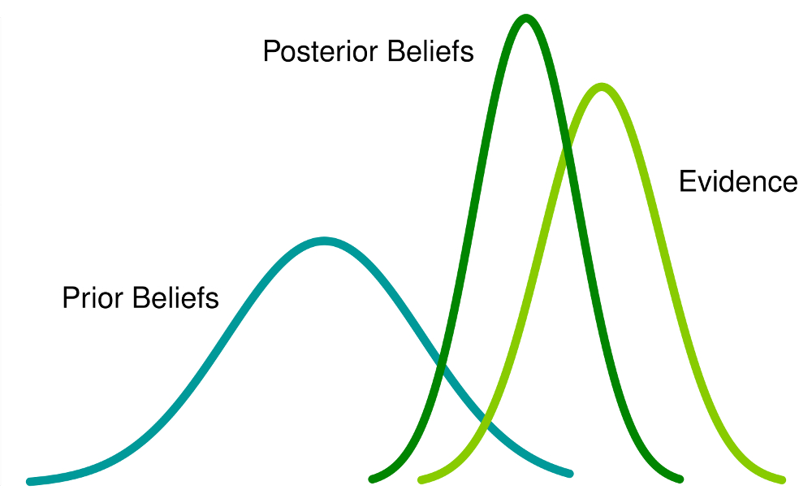
Learning through Bayesian Analysis
How do humans learn?
Updating beliefs based on new information/evidence
A Bayesian program fed with hand-written characters can invent new characters indistinguishable from ones produced by humans, as dramatized in this illustration.
https://blogs.scientificamerican.com/cross-check/are-brains-bayesian/

Slide 7
Review: Independent Events
Two events are considered Statistically Independent if the occurrence of one event does not depend on or is not (significantly) influenced by the occurrence of the other event under the same or similar conditions.
If A and B are (statistically) independent:
P(A | B) = P(A) or ~ P(A)
where P(A | B) is the “probability of A given the observed occurrence of B (or given B)”.

Slide 8
Review: Intersection of Dependent A and B
Probability that any A and any B occur simultaneously is P(A∩B).
For two events, we state the general expression for P(A∩B) in the two equivalent forms below, and then we can consider whether A, B can be approximated as independent.
P(A∩B) = P(A|B) P(B) or, P(A∩B) = P(B|A) P(A)
A uncertain, B observed
B uncertain, A observed
Recall the Chain Rule: P(A,B) = P(A|B)P(B) = P(B|A)P(A)

Slide 9
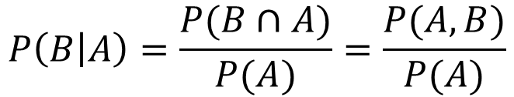
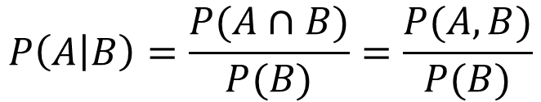
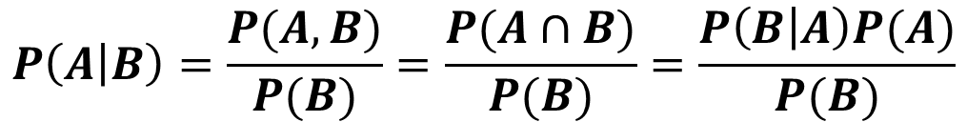
Bayes Rule
So,
Bayes Rule:
$$P\left(A | B\right)=\frac{P(A∩B)}{P(B)}=\frac{P(A,B)}{P(B)}$$
$$P\left(B | A\right)=\frac{P(B∩A)}{P(A)}=\frac{P(A,B)}{P(A)}$$
$$P\left(A,B\right)=P\left(A|B\right)P\left(B\right)=P\left(B|A\right)P(A)$$
$$P\left(A | B\right)=\frac{P(A,B)}{P(B)}=\frac{P(A∩B)}{P(B)}=\frac{P\left(B | A\right)P(A)}{P(B)}$$

Slide 10

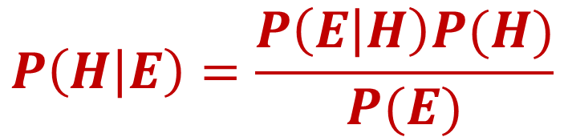
Bayes Rule: Evidence Based Reasoning
The posterior probability or belief in the hypothesis H given evidence E is expressed as
From Law of Total Probability (LTP):
$$P\left(E\right)=P\left(E | H\right)P\left(H\right)+P\left(E | \overline{H}\right)P\left(\overline{H}\right)=\sum_{i}{P\left(E|H_{i}\right)P(H_{i})}$$
Updated belief,
Pr of H=true|Evidence
(Posterior)
Initial belief,
Pr of Hypothesis=true
(Prior)
Pr of Evidence|H=true (Likelihood)
$$P\left(H | E\right)=\frac{P\left(E | H\right)P(H)}{P(E)}$$
Bayes Model:
not H

Slide 11
Probabilistic Reasoning
Begin with a hypothesis, H, for which you have an initial belief, P(H). This is called prior belief in H or Prior Probability of H.
Observe event, or gather data to revise your prior belief of the hypothesis, P(H). The observed data reflects the Likelihood, P(E|H), which is the probability of observing E given the hypothesis, H.
When likelihood P(E|H) is normalized/divided by P(E), the total Pr of the observed evidence, it yields the Posterior Probability of H given evidence E, or P(H|E). This is the updated belief about hypothesis H given observed evidence E.
P(H|E) contains the normalized overlap, or the normalized joint co-occurrence of the Prior information, P(H) and the observed Likelihood information, P(E|H).
You measure or estimate the Likelihood, P(E|H), of the evidence, E, given the hypothesis, H, not the hypothesis itself. We update the hypothesis (not prove it!)

Slide 12
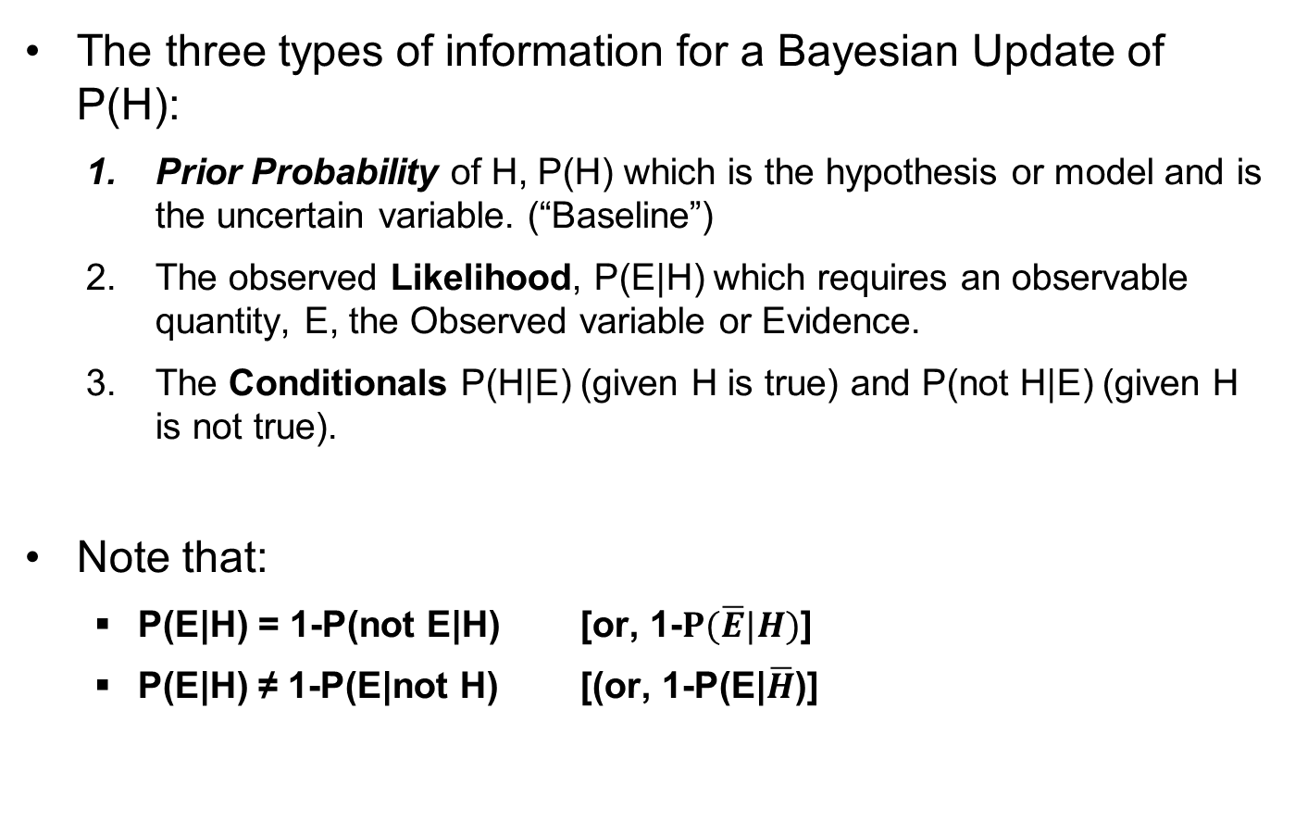
Probabilistic Reasoning
The three types of information for a Bayesian Update of P(H):
Prior Probability of H, P(H) which is the hypothesis or model and is the uncertain variable. (“Baseline”)
The observed Likelihood, P(E|H) which requires an observable quantity, E, the Observed variable or Evidence.
The Conditionals P(H|E) (given H is true) and P(not H|E) (given H is not true).
Note that:
P(E|H) = 1-P(not E|H) [or, 1-$P(\overline{E}|H)$]
P(E|H) ≠ 1-P(E|not H) [(or, 1-P(E|$\overline{H}$)]

Slide 13
Probabilistic Reasoning Example
A chest clinic has 1000 patients. We need to find the Pr that a patient has cancer (hypothesis H), given we observe the patient smokes (evidence S). Information given:
50 patients have cancer: P(H = cancer) = 50/1000= 0.05 (Prior)
500 patients smoke: P(E = smoker) = 500/1000= 0.5 (Evidence)
40 of the 50 cancer patients are smokers: P(E|H)= 40/50= 0.8
Using the Bayes model, the Posterior Probability of having cancer (H) given a patient is a smoker (E) is predicted from:
Our belief/probability that someone has cancer (0.05) just went up to 0.08 because we observed a higher probability of cancer among smokers (0.8).
$$P\left(H | E\right)=\frac{P(H∩E)}{P(E)}=\frac{P\left(E | H\right)P(H)}{P(E)}=\frac{0.8(0.05)}{0.5}=\frac{n_{HE}}{N_{E}}=0.08$$

Slide 14
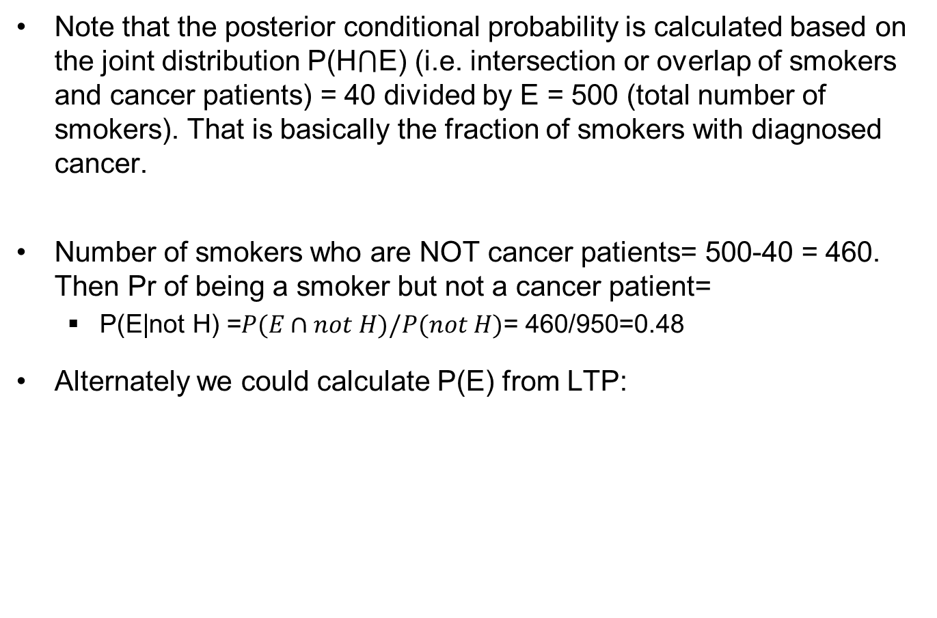
Probabilistic Reasoning Example
Note that the posterior conditional probability is calculated based on the joint distribution P(H⋂E) (i.e. intersection or overlap of smokers and cancer patients) = 40 divided by E = 500 (total number of smokers). That is basically the fraction of smokers with diagnosed cancer.
Number of smokers who are NOT cancer patients= 500-40 = 460. Then Pr of being a smoker but not a cancer patient=
$\text{P}\text{(}\text{E}\text{|}\text{not} \text{H}\text{) =}P(E∩not H)/P(not H)$= 460/950=0.48
Alternately we could calculate P(E) from LTP:
P(E) = P(E|H)∙P(H)+P(E|not H)∙P(not H) = 0.8(0.05)+(0.48)(0.95) = 0.5
0.8
0.05
0.48
0.95

Slide 15
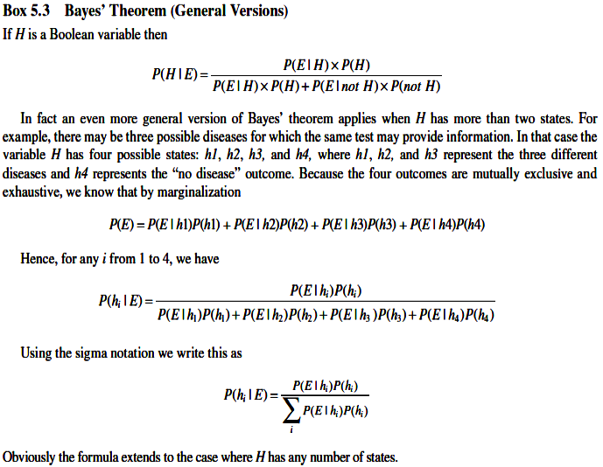
H can have many discrete states:
Bayes:
(RDBN, 2012)

Slide 16
Denominator of Bayes Equation
Denominator P(B) is also called marginal distribution of B (Evidence summed over all uncertain A_{i}), and is the normalization factor of the Bayes expression to result in the posterior probability
The total probability of B, P(B), is also called the Prior Predictive Probability of the Observed Variable (Prior PPOV) B, which is predicted based on prior P(A) information.
The LTP summation is over all A_{i} to eliminate A and to obtain the total probability of B.
By the LTP:

Slide 17
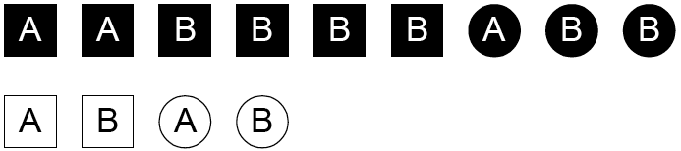
Review: Using Bayes Model
If A is the set of all objects containing A; B is the set containing B; and Black is the set of all black objects, then find P(Black|A)
From direct calculation: P(Black|A) = 3/5
From Bayes:
(Neapolitan, 2009)

Slide 18
Heart Disease Medical Case Study
Recall that all measurements are uncertain, so there is always false positive and false negative uncertainty.
Question: If a randomly selected person tests positive, what is the probability that he actually has the disease?
Given an observed heart disease, H, with occurrence frequency of 1/1000 in the local population:
Prior probability: P(H) = 10⁻³
So, P(not H) = 1-Pr(H) = 1-10⁻³ = 0.999

Slide 19
Heart Disease Medical Case Study
For those who have the disease:
Tests are 100% accurate, i.e. it correctly gives a positive result for people who have the disease:
P(E|H) = 1, where E = positive result
And, Pr of a false negative result = P(not E|H) = 0
For those who do NOT have the disease:
Tests are 95% accurate (or 5% inaccurate), i.e. 5% who do not have the disease is wrongly tested positive
Pr (not E|not H)= 0.95
And Pr of a false positive result = P(E| not H) = 0.05
If a randomly selected person tests positive, what is the probability that he actually has the disease?

Slide 20
H = Heart Disease Hypothesis, E = Positive Test
Prior predictive probability of a positive test E (probability that someone tests positive with or without the disease ):
P(E) = P(E|H)P(H) + P(E|not H)P(not H) = 1 x 0.001 + 0.05 x 0.999 = 0.05095
Pr of actually having the disease when tested positive:
Pr of not having the disease when tested positive:
Testing positive when actually having the disease is P(H|E) = 0.02, which is much lower than one would intuitively expect.
true positive
false positive
Sum to 1

Slide 21
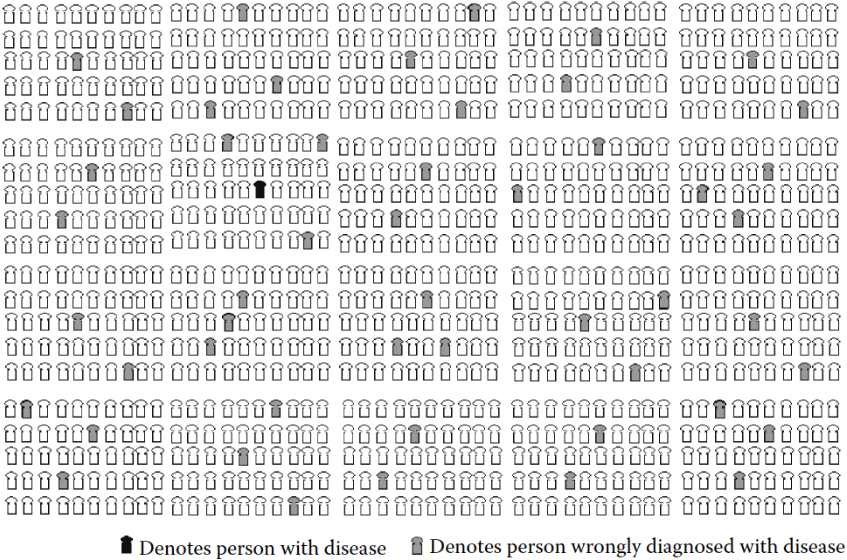
1 person in 1,000 has the disease, but 49 more people in 1,000 are incorrectly diagnosed with the disease.
(RDBN, 2012)

Slide 22
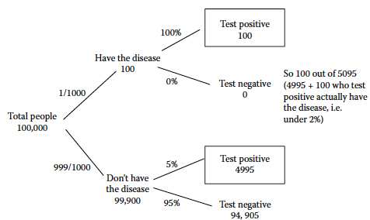
Medical Example Explained by Decision Tree
For effective risk communication, graphical explanations such as the tree figure below can be more convincing to company stakeholders and the public than a calculation from the Bayes model alone.
False negative
False positive
Most of the people who test positive don’t have disease:
(RDBN, 2012)

Slide 23
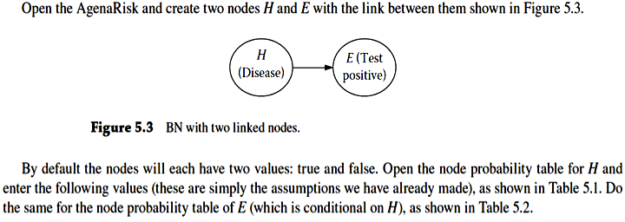
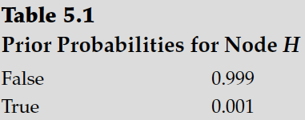
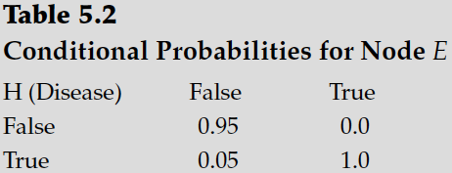
Calculation in AgenaRisk: Two-Node BN
P(E|H) = P(E,H)/P(H)
Prior
Likelihood
Input the following data in each node:
Data: Prior Probability
Data: Conditional Probability
false positive

Slide 24
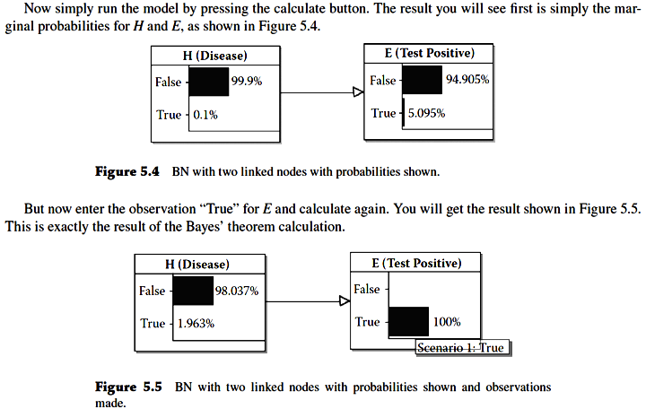
Calculation in AgenaRisk
Cause
Effect
Prior
Prior P(H)
1 in 1000
P(E): total Pr of observing someone test +ve (with or w/o disease)
Marginal Probability P(E) = P(E|H)P(H) + P(E|not H)P(not H) = 1 x 0.001 + 0.05 x 0.999 = 0.05095

Slide 25
Updating model based on evidence:
Updating prior information based on test observation:
Likelihood/ Observation
Update the Prior given a positive test:
Posterior P(H|E)
~ 0.02
Instantiation

Slide 26
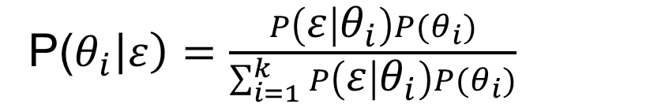
Review: Bayes Discrete Model
Bayes model for each value of p:
P(θ _{i}): prior Pr of θ_{i}, from expert judgment
P(ε| θ_{i}): likelihood that the observed condition will support θ_{i}
P(ε): Prior predictive probability of observing evidence, ε
P(θ _{i} |ε): Posterior predictive probability of θ
P(θ_{i}|ε): fraction of ε due to ε- θ_{i} overlap in P(θ_{i},ε)
P($θ_{i}\left|ε\right)=\frac{P\left(ε | θ_{i}\right)P(θ_{i})}{\sum_{i=1}^{k}{P\left(ε | θ_{i}\right)P(θ_{i})}}$
P(ε)
θ= parameter of interest

Slide 27
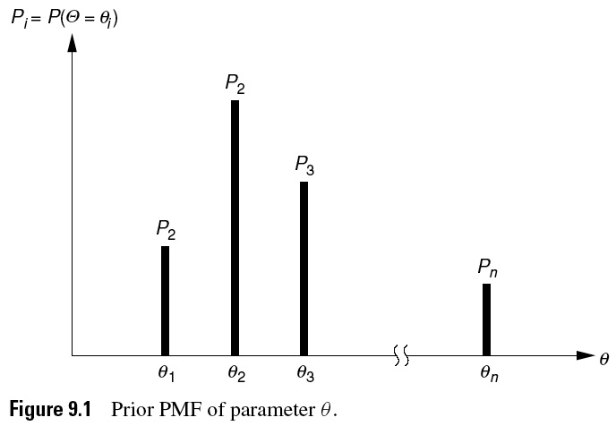
09_01
Probability Mass function P(θ_{i}), Discrete (pmf)
Probability, along y-axis, that parameter θ has the given discrete values, along x-axis.
In working Bayes problems, sketch the prior (initial) and posterior (final) distributions to show the effect of the update on the likelihood observations.
1
(Ang, PCE)
Notes:
09_01.jpg

Slide 28
Bayes Model Updating
Following determination of the marginal probability, we may perform a test and then update our prior probabilities.
Recognize that the posterior calculated from this will form the prior for a 2nd update and so on.
The previous Posterior becomes the new Prior
If P’(θ_{i}) represents the first prior, P”(θ_{i}|ε) is the updated Bayes estimate (posterior) that is then used as a prior for the second Bayes estimate

Slide 29
Discrete Bayesian Case Study
In this study, a construction engineer uses his experience to estimate the probabilities that different proportions of concrete piles have defects and ‘updates’ his opinion based on inspecting the concrete piles
Defects in concrete piles for buildings can be due to insufficient bonding with steel, out of tolerance length, cracks, voids etc.
Estimate the proportion of defective piles, p
Engineer thinks θ ranges from 0.2 (20% defective) to 1 (all defective). (Probability P of observing a certain proportion of defects, θ, in a given number of piles), with 0.4 being the most likely value (see figure in next slide)
Prior probability of θ, obtained from expert opinion: P’(θ): probability of observing each value of θ

Slide 30
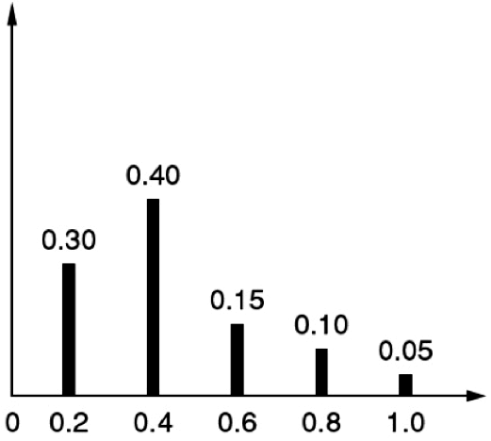
E_09_01a
1
θ: proportion of defective piles
P’(θ): Prior probability (from expert judgment) that the proportion of defective piles = θ
P’(θ)
All data are in these five bars of the discrete pmf distribution (total Pr = 1)
Prior Pr
values
θ
θ values, likelihood data
(Ang, PCE)
Notes:
E_09_01a.jpg

Slide 31
Bayesian Parameter Estimator
Prior predictive probability (denominator) is found using the LTP:
prior weight
For 1st update:
test data
posterior weight
For 2nd update:

Slide 32
Observing a defective pile
Inspection of a pile shows it is defective (similar to testing positive in the heart disease example)
So we have to update each of the expert opinions P(θ) by calculating values for the P(θ|ε) posterior distribution for all 5 values of P(θ)

Slide 33
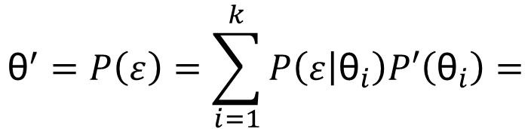
First: Calculate P(ε)
First use the data to calculate the total probability of observing a defective pile, P(ε), by summing over all the p_{i} from 0.2 to 1.
So, the probability of observing a defective pile:
$${\text{θ}}^{′}=P\left(ε\right)=\sum_{i=1}^{k}{P\left(ε | {\text{θ}}_{i}\right)P′\left({\text{θ}}_{i}\right)=}$$
likelihood
prior
likelihood
prior
likelihood
prior
likelihood
prior
likelihood
prior

Slide 34
Observing a defective pile
Calculate using Bayes equation
Begin by updating the prior P(θ) = 0.30 using the corresponding likelihood P(ε|θ) = 0.2:
θ
reduced from prior
Likewise,
reduced
increased
θ
θ
θ
θ
increased
increased

Slide 35
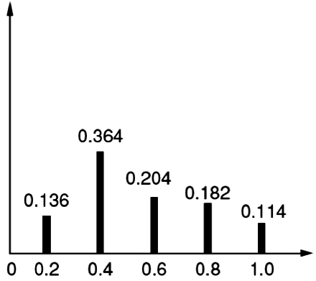
E_09_01b
Compare Posterior with Prior Distribution for p
P”(θ|ε): Posterior probability of defective pile following 1 inspection showing a defective pile
θ: proportion of defective piles
ε = observed defective pile, 1st inspection
P”(θ)
decreased
increased
Compare posterior P”(θ) distribution with prior P’(θ) distribution given test information of a defective pile.
(Ang, PCE)
Notes:
E_09_01b.jpg

Slide 36
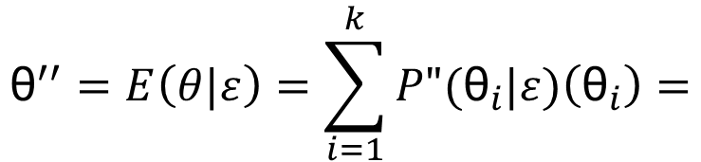
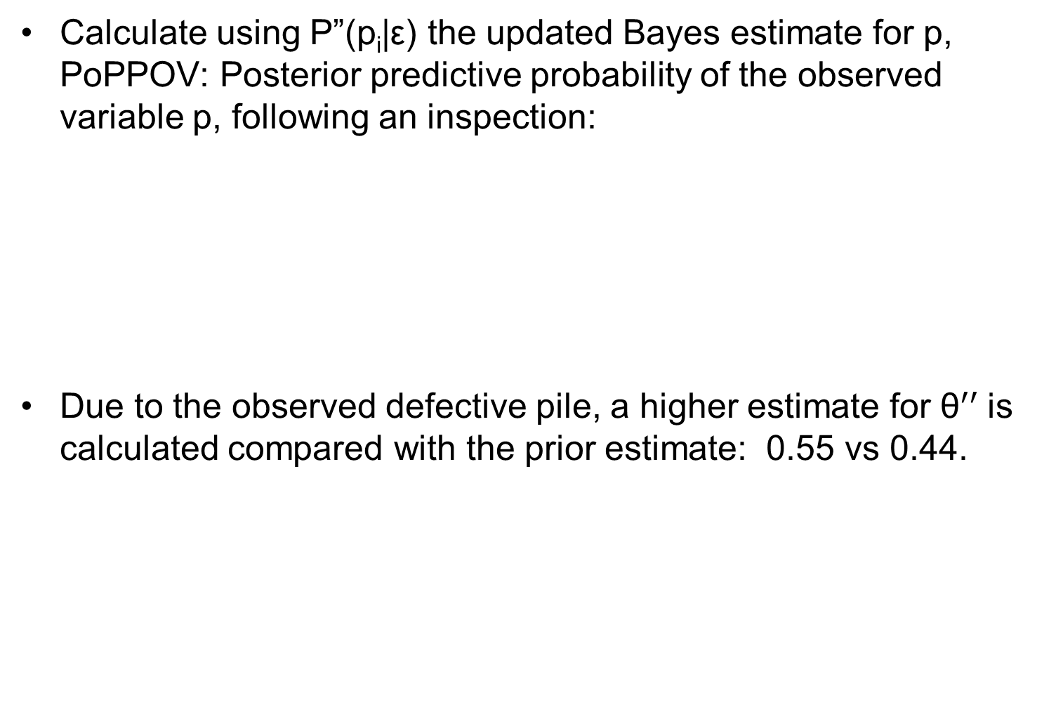
Estimate for p, after inspection
Calculate using P”(p_{i}|ε) the updated Bayes estimate for p, PoPPOV: Posterior predictive probability of the observed variable p, following an inspection:
Due to the observed defective pile, a higher estimate for ${\text{θ}}^{′′}$is calculated compared with the prior estimate: 0.55 vs 0.44.
posterior
$${\text{θ}}^{′′}=E\left(θ|ε\right)=\sum_{i=1}^{k}{P"({\text{θ}}_{i}|ε)\left({\text{θ}}_{i}\right)=}$$

Slide 37

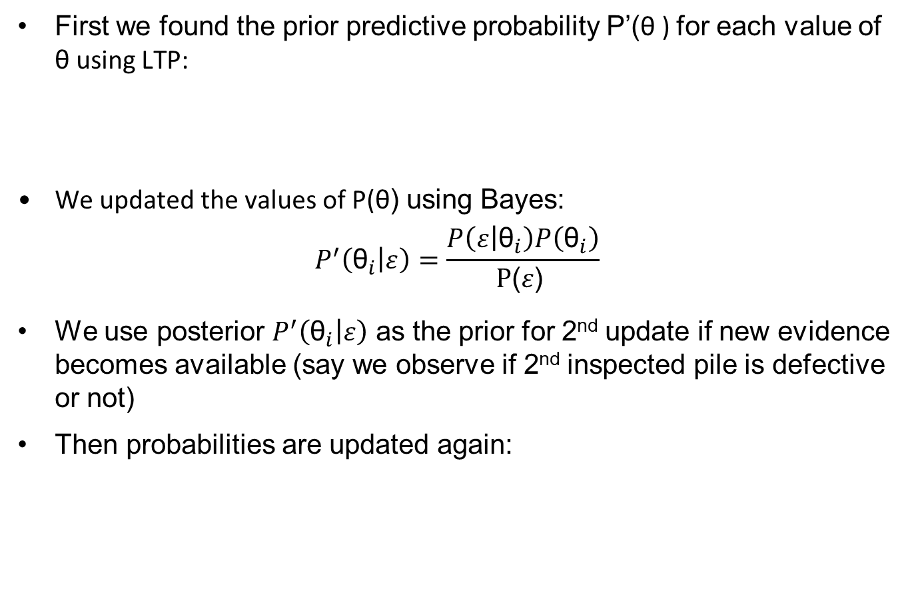


Review
First we found the prior predictive probability P’(θ ) for each value of θ using LTP:
We updated the values of P(θ) using Bayes:
$$P^{′}\left({\text{θ}}_{i} | ε\right)=\frac{P\left(ε | {\text{θ}}_{i}\right)P\left({\text{θ}}_{i}\right)}{\text{P}\text{(}ε\text{) }}$$
We use posterior $P^{′}\left({\text{θ}}_{i} | ε\right)$ as the prior for 2nd update if new evidence becomes available (say we observe if 2nd inspected pile is defective or not)
Then probabilities are updated again:
$${\text{θ}}^{′}=P\left(ε\right)=\sum_{i=1}^{k}{{\text{θ}}_{i}P′\left({\text{θ}}_{i}\right)}$$
$${\text{θ}}^{′′}=P′\left(ε\right)=\sum_{i=1}^{k}{{\text{θ}}_{i}P′′\left({\text{θ}}_{i}\right)}$$
where, P’’(${\text{θ}}_{i}$)= $P^{′}\left({\text{θ}}_{i} | ε\right)$

Slide 38
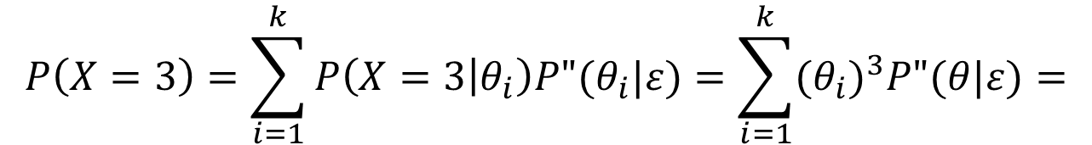
Probability of Column Sag
Each building column requires support of 3 concrete piles. If all 3 piles are defective, the column will sag.
Following an inspection showing a defective test pile, calculate the Pr a column will sag: P(X=3). Use LTP:
Given additional defective pile observations, the predicted probability of sag is increased. (Why, based on Posterior PPOV weight factors?)
1⋂2⋂3, assumed independent here
$$P\left(X=3\right)=\sum_{i=1}^{k}{P\left(X=3 | θ_{i}\right)P"(θ_{i}|ε)=\sum_{i=1}^{k}{{(θ_{i})}^{3}P"(θ|ε)=}}$$

Slide 39
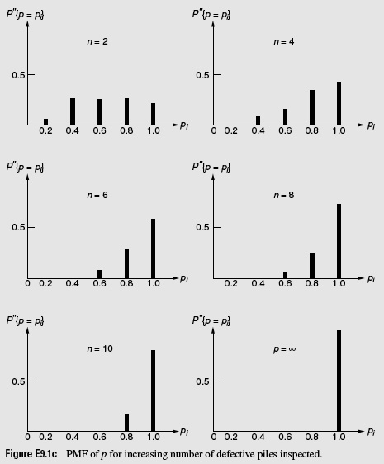
E_09_01c
P(θ|ε): Defective Piles Observed in n > 1 Consecutive Tests
Posterior Probability Distribution Following Tests
(Ang, PCE)
Notes:
E_09_01c.jpg

Slide 40
Discussion of Trends in P(θ|ε)
Following repeated consecutive observations of defective piles, the posterior distributions of θ will migrate toward larger θ values.
Following 1 or more tests that observe non-defective piles (with non-defective proportions 1– θ_{i}), the posterior distributions of θ will migrate toward smaller θ values.
This is an example of Bayes modeling, rapid data updating of probability as new information becomes available, and uncertainty analysis to support more accurate or more up to date and more realistic forecasts.

Slide 41
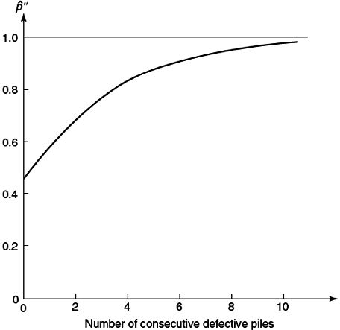

E_09_01d
Defective Piles Observed in n Consecutive Tests
$$θ"= \sum_{i=1}^{k}{P"({\text{θ}}_{i}|ε)\left({\text{θ}}_{i}\right)}$$
θ”
Bayes estimator for p based on Posterior (Prior information intersecting new data)
Original prior, P’(ε) = 0.44. Each subsequent Prior is the previous Posterior distribution containing the latest ε test observation
(Ang, PCE)
Notes:
E_09_01d.jpg

Slide 42
Case Study Conclusions
In the absence of a sufficient amount of observed data, expert judgment information is more critically needed.
Based on frequent system monitoring, the amount of observed system specific data eventually dominates more uncertain prior generic data and expert estimates as the subsequent priors are increasingly more weighted by observed system data.
How rapidly observed data dominate depends on amount and quality of the observed likelihood data compared to amount and quality of the prior information.

Slide 43
Conclusions: Bayes Model Attributes
The Bayes model is adaptive to causal information or evidence as they becomes available to revise degree of belief in the event occurrence probability.
Bayes analysis supports the simplest hypothesis or model that is consistent with the data and therefore the most plausible. For system modeling, it supports the simplest model consistent with the data.
All probability is conditional and to some extent subjective in representing belief in an event or hypothesis, but the Bayesian reasoning process for data analysis is inherently objective, coherent, and it propagates the uncertainties (from the prior data, likelihood model, and model parameters).
The Bayes model is an indispensable system approach method for computing conditional probabilities, testing evidence, propagating uncertainties, avoiding misconceptions, fallacies, biases, promoting coherent reasoning and more accurate predictions for optimum decision making under uncertainty and effective risk management.
(RDBN, 2012)

